Slide 1


Clinical Problem Solving CARDIOLOGY + INTERNAL MEDICINE
IN THE NAME OF GOD
Fatemeh ziaeifar, MD
CARDIOLOGY RESIDENT
February 2026

Slide 2
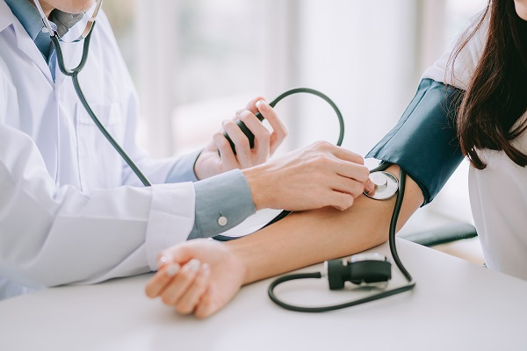
STEP 1

Slide 3
ID
62 Y/O WOMAN
FROM TEHRAN
MARRIED

Slide 4
CHIEF COMPLAINT
Shortness of breath
and
Weakness

Slide 5
Present Illness
A 62-year-old woman with past medical history of hypertension, hypothyroidism, minor thalassemia presented with progressive shortness of breath and weakness from three months ago.
The dyspnea occurs with mild exertion and is consistent with NYHA functional class III.
The dyspnea does not vary at different times of the day.
She also complains of hoarseness.
Cough wheezing hemoptysis
orthopnea paroxysmal nocturnal dyspnea (PND)
fever flu-like symptoms

Slide 6
Past Medical History
hypertension
hypothyroidism
minor thalassemia

Slide 7
Drug History
Losartan 25 mg Daily
Levothyroxine 100 mcg Daily

Slide 8
Past Surgical History : Unremarkable
Social History : Unremarkable
Allergy History :No known drug allergies.
Family History : Unremarkable

Slide 9
Physical exam
The patient appears alert and oriented with dyspnea (FC III)
ill toxic
Vital Signs:
Blood pressure: 115/82 mmHg
Heart rate: 90 beats per minute
Respiratory rate: 20 breaths per minute
Temperature: 36.8 °C
Oxygen saturation: 93% on room air

Slide 10
Physical exam
skin: thickened and tight skin over the chin
Head and Neck: JVP was elevated Cardiovascular: S1 and S2 was auscultated
Respiratory: Chest expansion normal, lungs clear to auscultation bilaterally

Slide 11
Physical exam
Abdomen: Soft, non-tender, non-distended, No organomegaly or ascites, Bruit were not heard in the abdomen
Extremities: Bilateral pitting edema 2+, involving the lower extremities.
Neurologic: Grossly intact. No focal neurologic deficits. Normal proximal and distal force.

Slide 12
Summary
A 62 year old woman with history of HTN, hypothyroidism, and minor thalassemia who presented with progressive dyspnea and weakness from 3 months ago.
She had Bilateral pitting edema 2+ and vocal hoarseness
and thickened skin over the chin

Slide 13
Differential Diagnosis ???

Slide 14
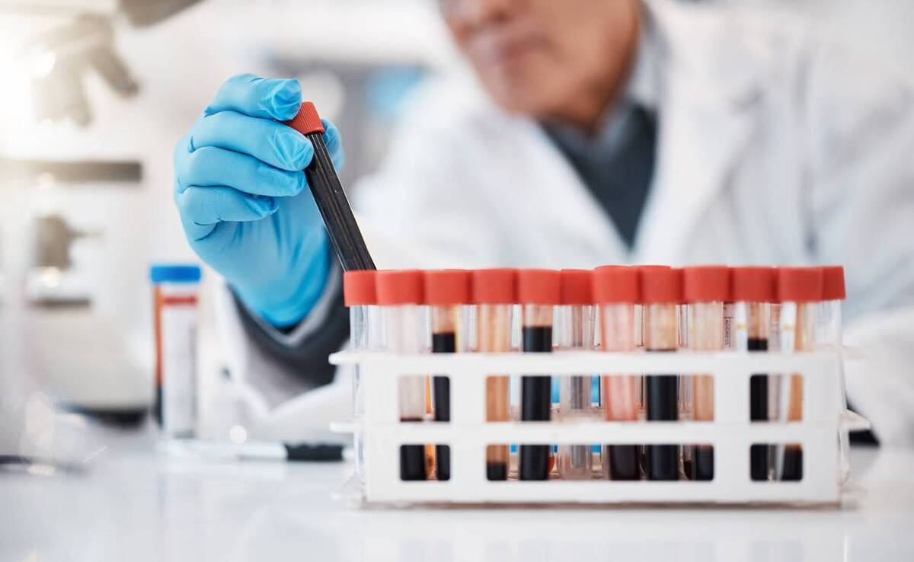
STEP 2

Slide 15
Laboratory Results
Test | Result | Unit
pH | 7.39
pCO₂ | 38.8 | mmHg
HCO₃ | 23.7 | mEq/L
Urea | 36.7 | mg/dL
Creatinine | 0.99 | mg/dL
AST | 31 | U/L
ALT | 44 | U/L
ALP | 220 | U/L
Bilirubin total | 1.61 | mg/dL
Bilirubin direct | 0.62 | mg/dL
Albumin | 4.3 | g/dL
Calcium | 10 | mg/dL
Phosphate | 2.9 | mg/dL
Test | Result | Unit
WBC | 6.44 | x10³/µL
Neutrophils | 69.2 | %
Lymphocytes | 20.3 | %
Hemoglobin | 10 | g/dL
RBC | 5.06 | x10⁶/µL
MCV | 58.2 | fL
Platelets | 172 | x10³/µL
PT | 24.2 | sec
INR | 1.94
PTT | 58 | sec
CRP | 3.1 | mg/L
Sodium | 142 | mEq/L
Potassium | 4.2 | mEq/L
Magnesium | 2.4 | mg/Dl
Test | Result | Unit
TSH | 8.3 | %
Vit D3 | 47 | ng/mL
Trp I | 0.03 | U/L
U/A | Pro: 2+
TIBC | 262 | µg/dL
Serum Iron | 53 | µg/dL

Slide 16
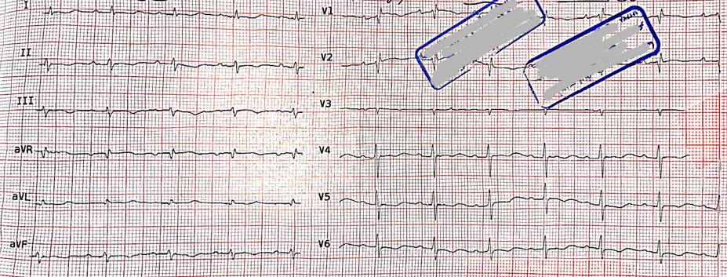
ECG

Slide 17
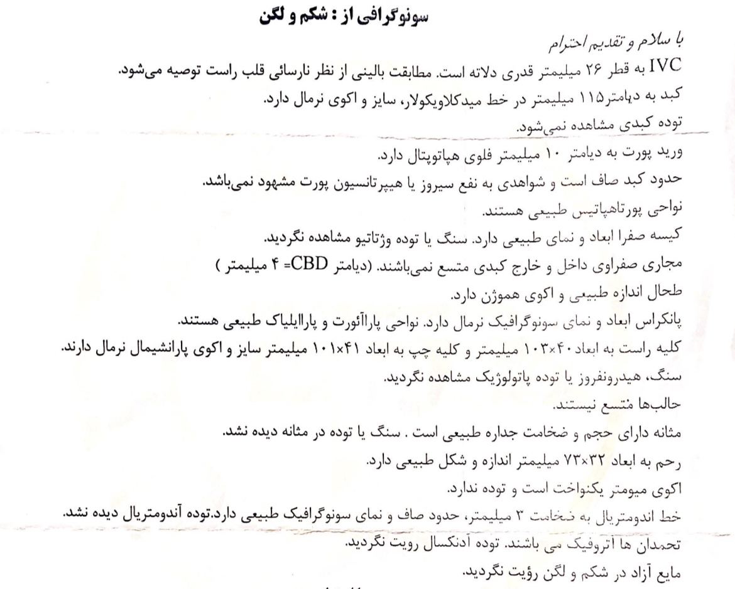
Sonography

Slide 18
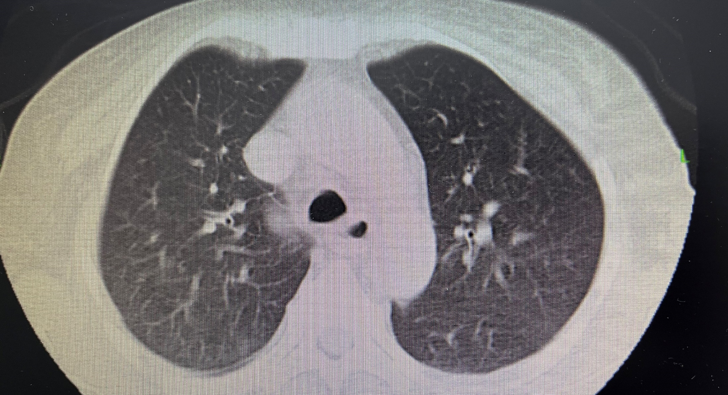
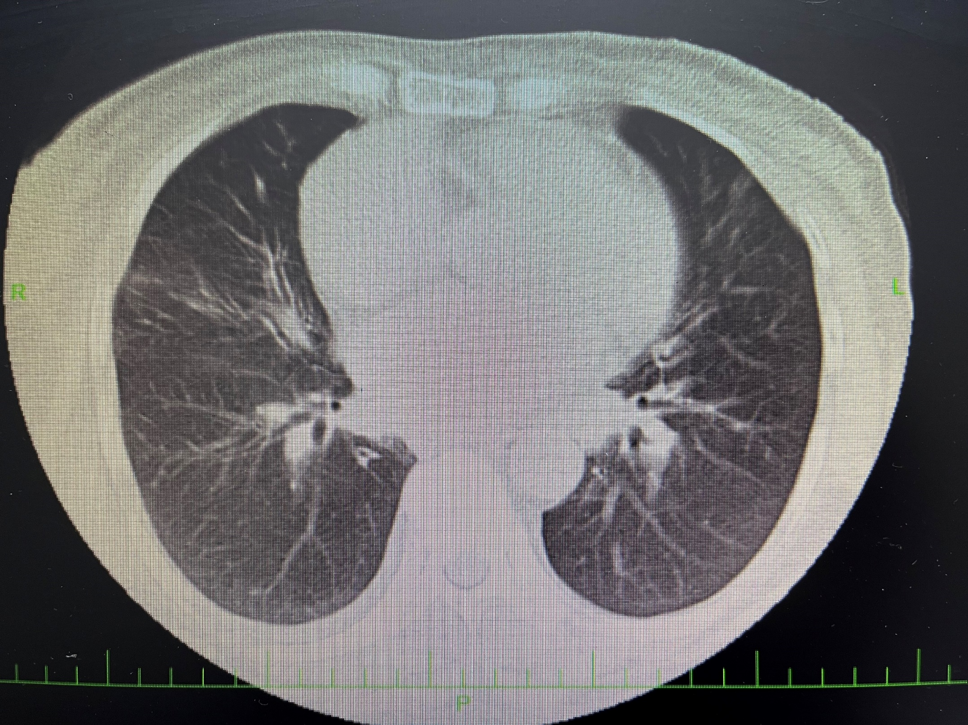
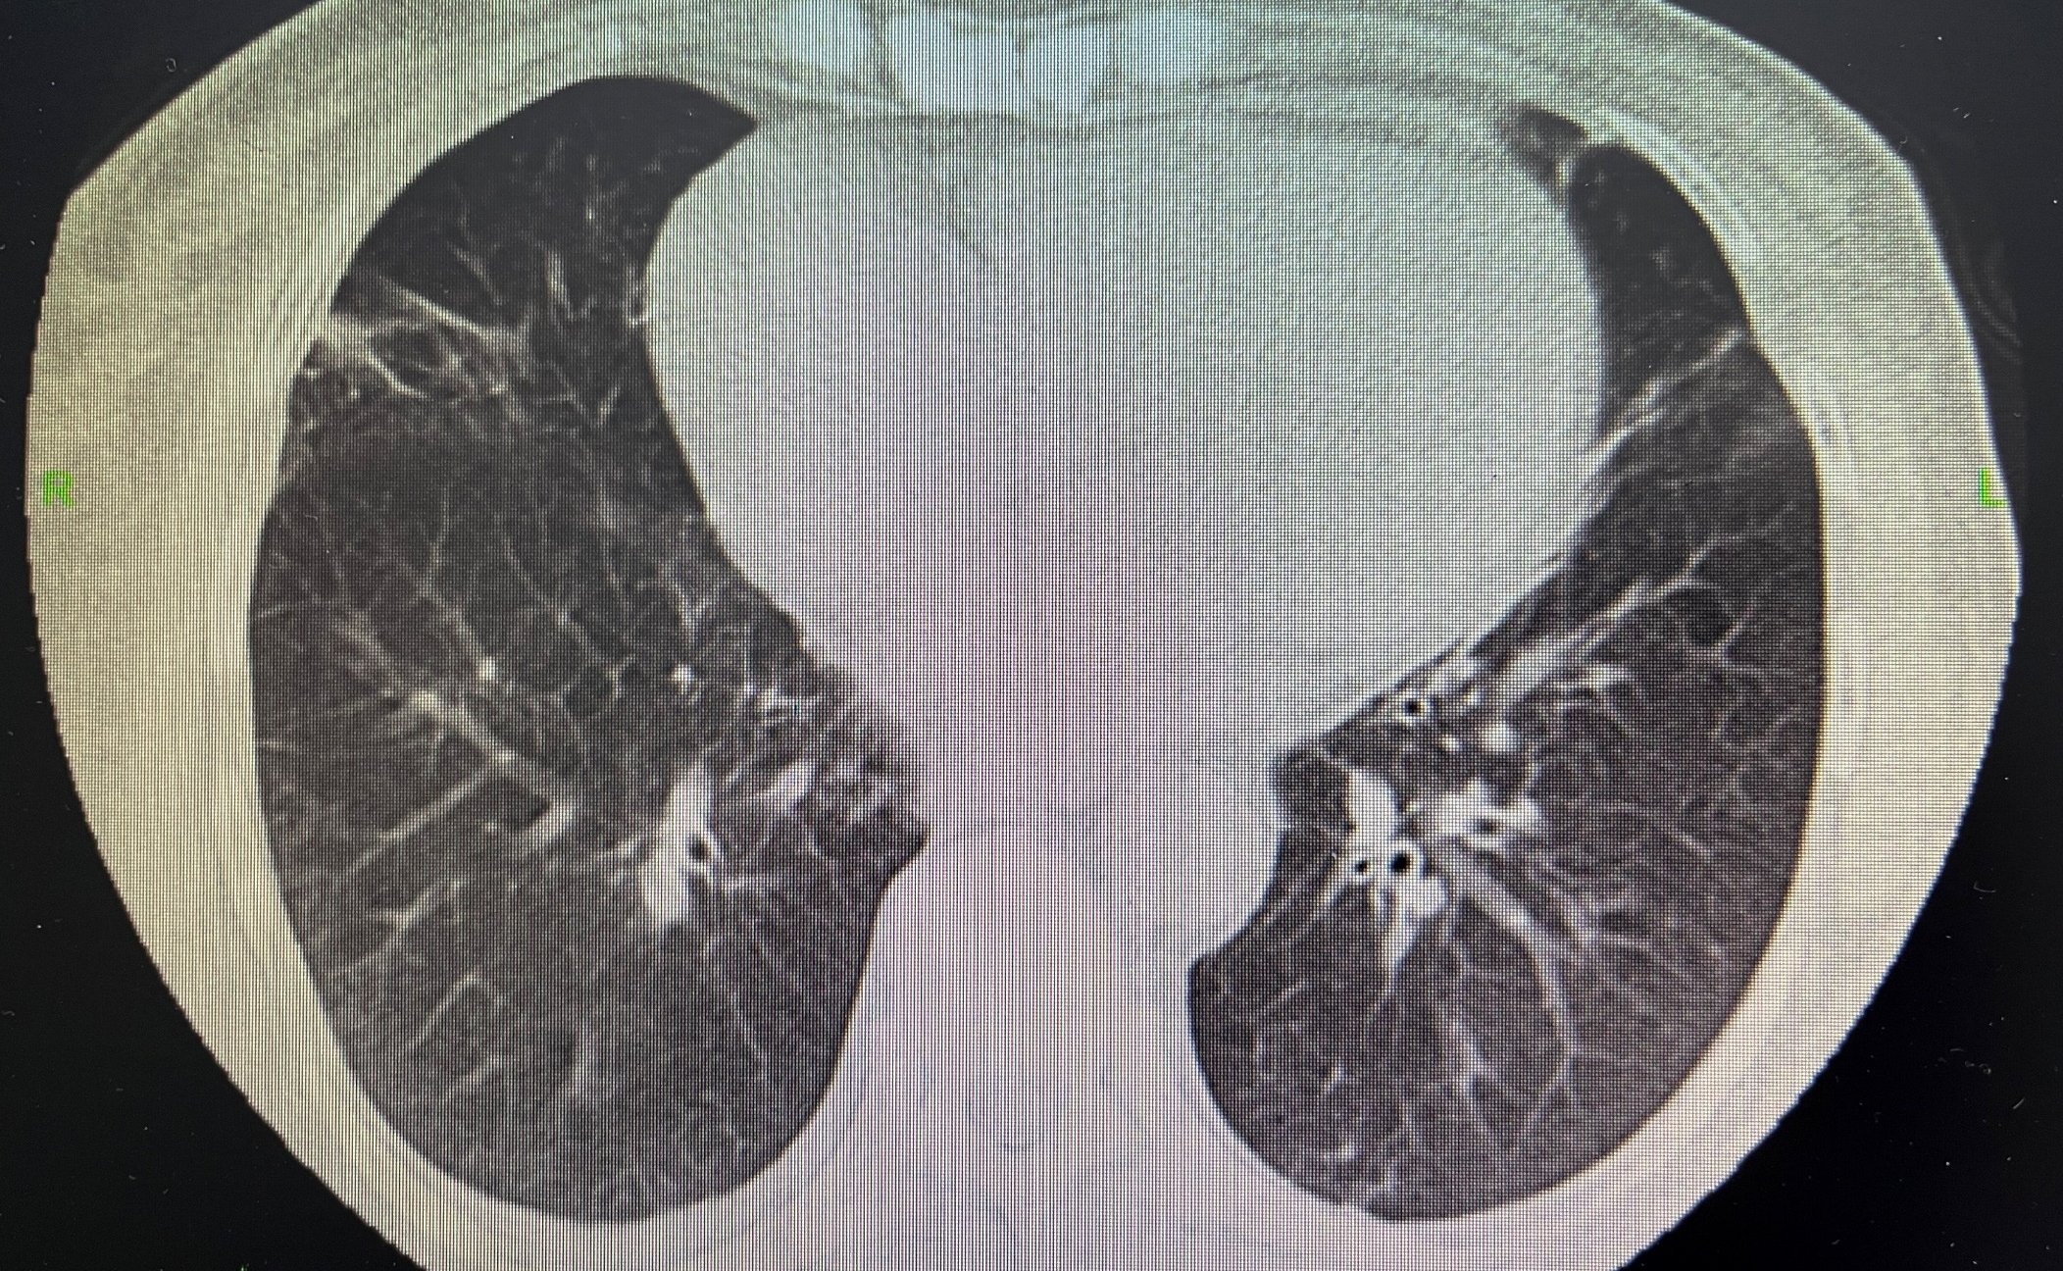
Chest CT scan

Slide 19
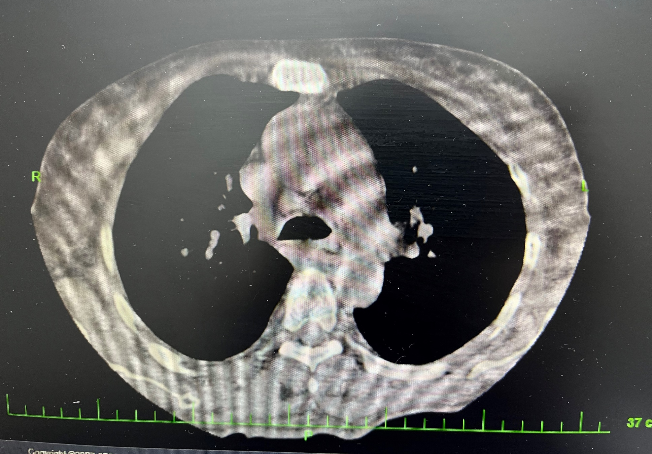
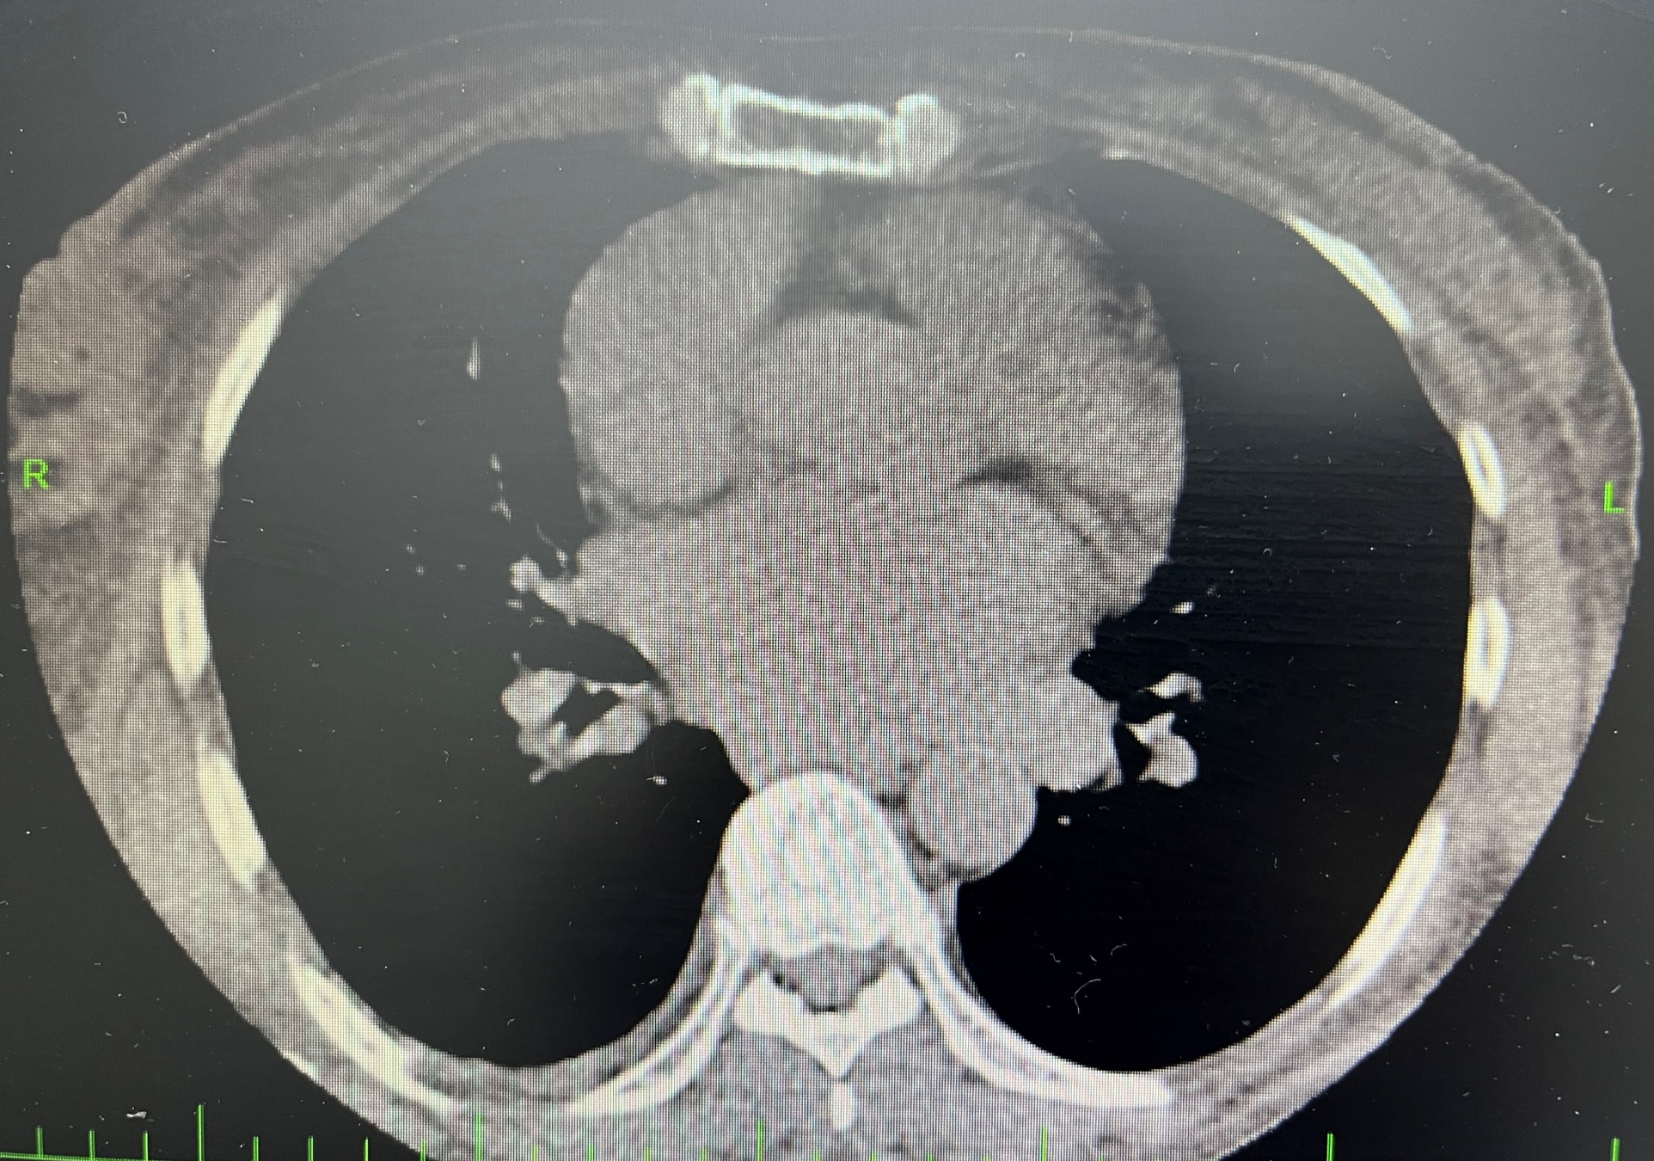
Chest CT scan

Slide 20
Chest CT scan report
سی تی اسکن اسپیرال قفسه سینه بدون تزریق:
ادم نسج نرم زیر جلدی رویت شد. باندهای فیبرواتلکتاتیک در فیلد ریه ها رویت شد. بافت ریه دانسیته و هواگیری طبیعی داشته، عروق و راه های هوایی طبیعی بوده و ندول دیده نشد. مدیاستن ،حفرات قلب و عروق اصلی مدیاستن سایز نرمال داشته و ضایعه ای در آنها دیده نشد. . مهره های توراسیک و بافت نرم طبیعی به نظر میرسد. پلور دو طرف نرمال بوده و شواهدی از افزایش ضخامت یا افیوژن دیده نشد.

Slide 21

STEP 3

Slide 22
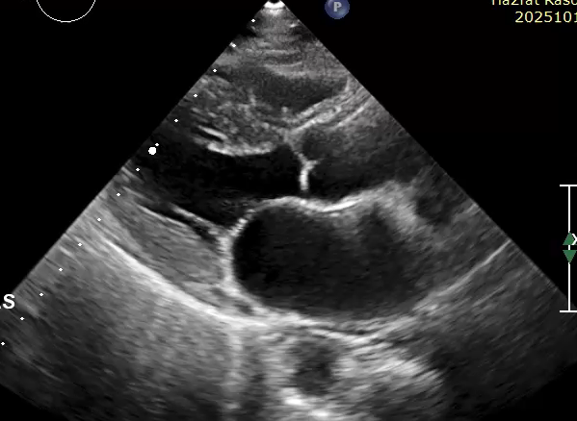
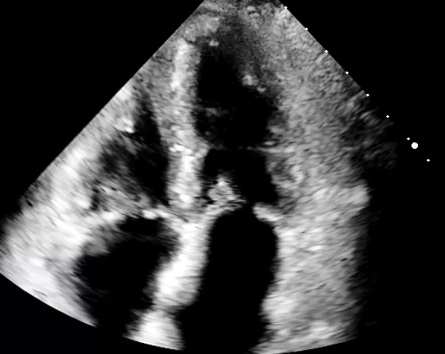
Echocardiography

Slide 23
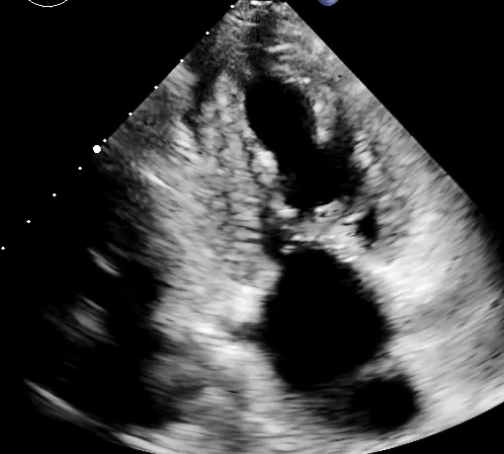
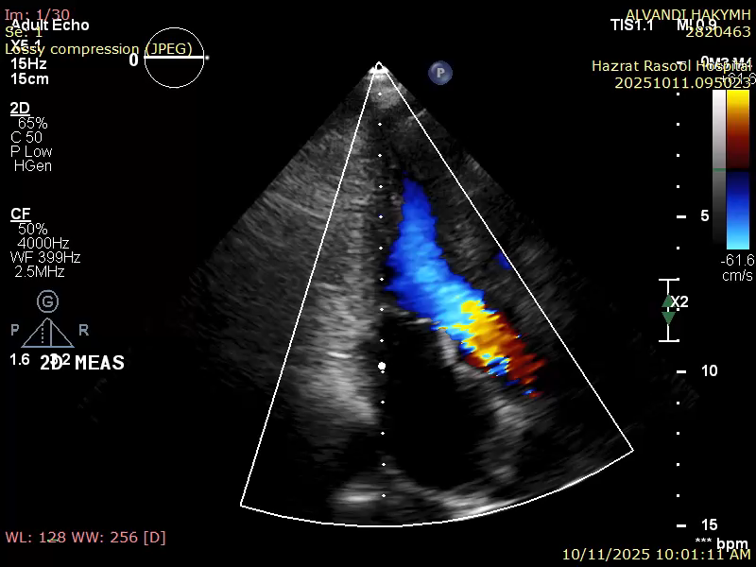
Echocardiography

Slide 24
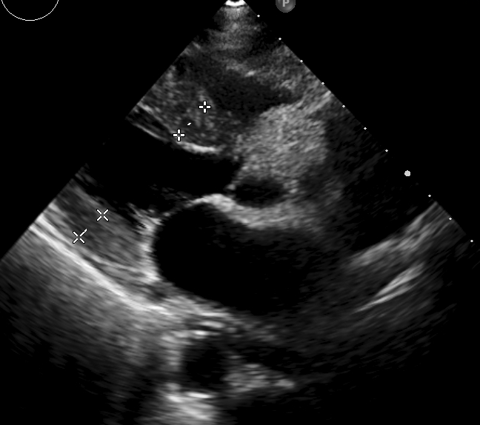
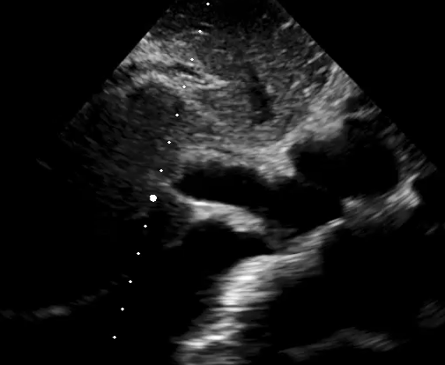
Echocardiography

Slide 25
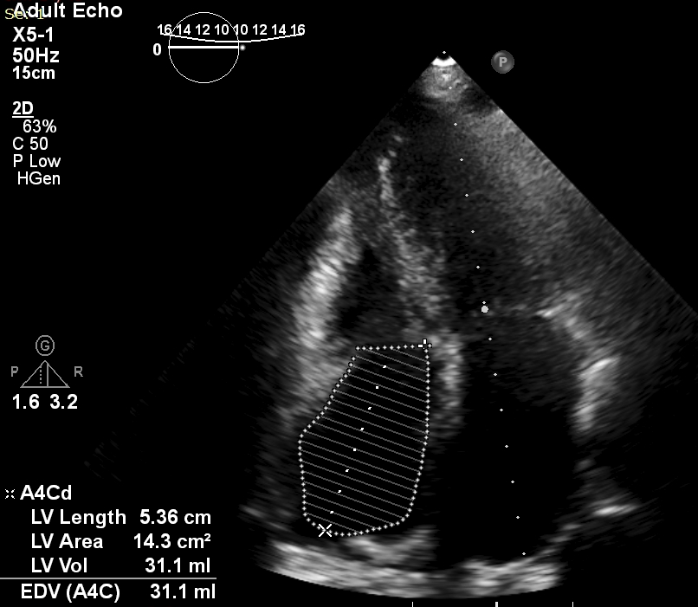
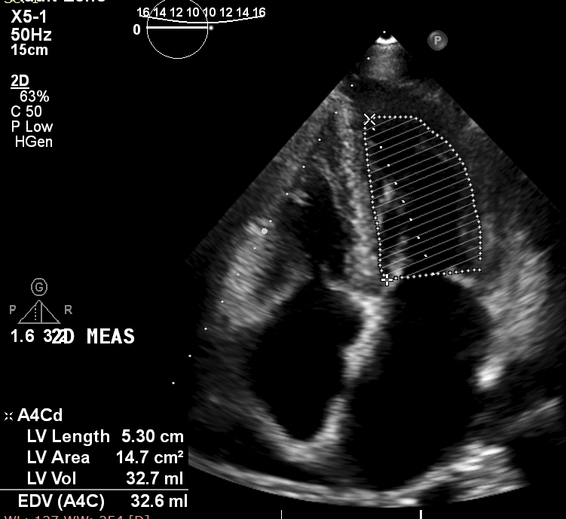
Echocardiography

Slide 26
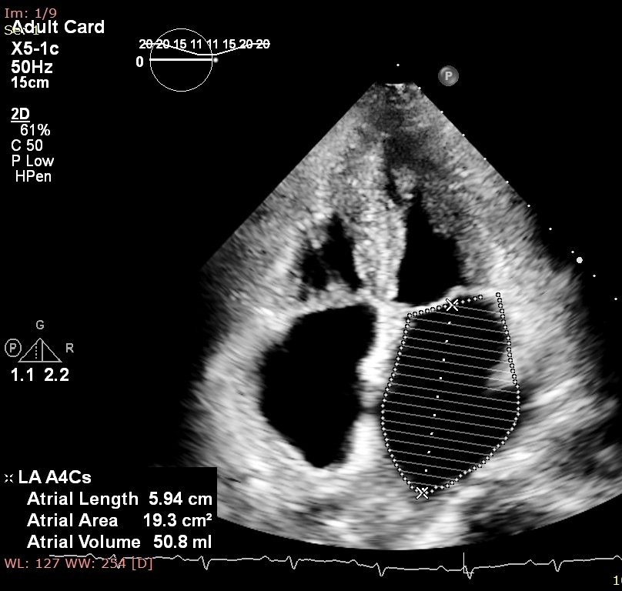
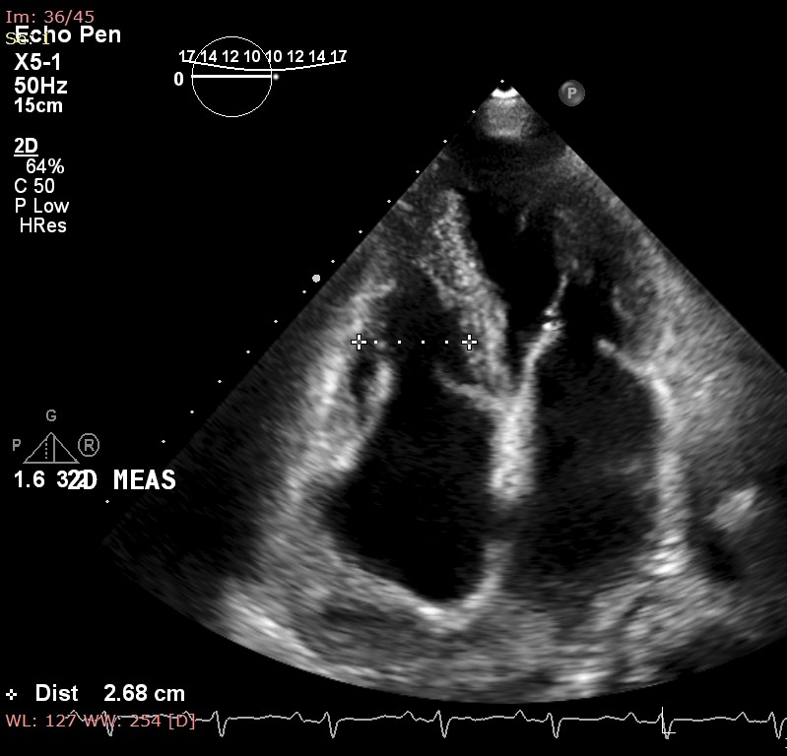
Echocardiography

Slide 27
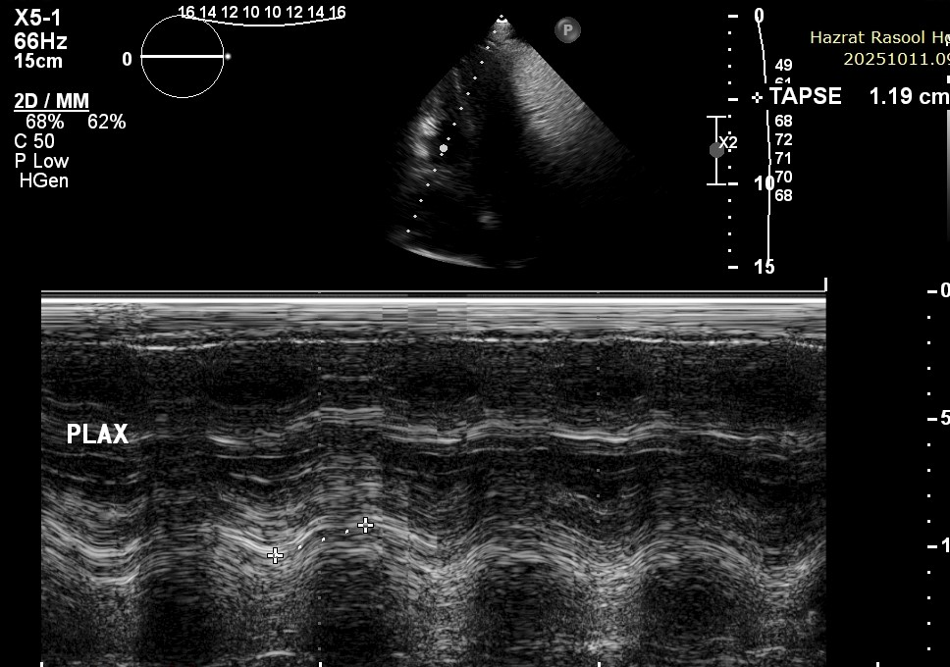
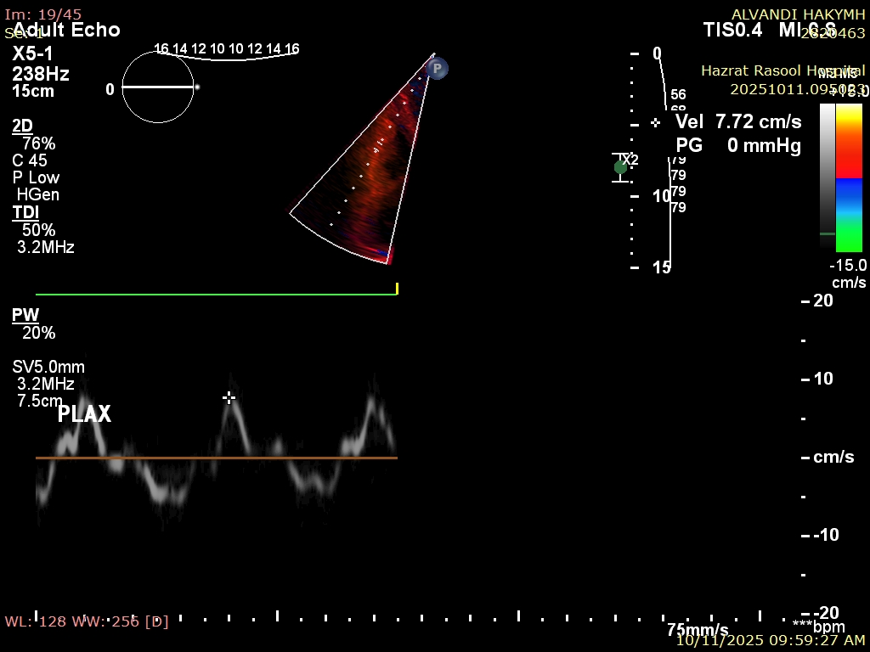
Echocardiography

Slide 28
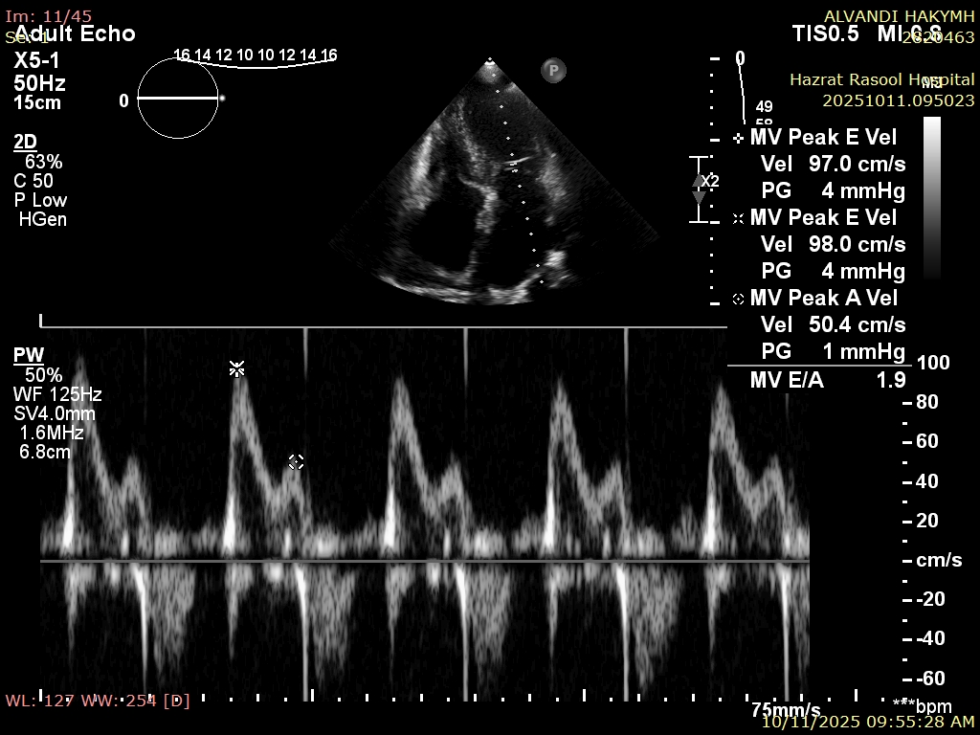
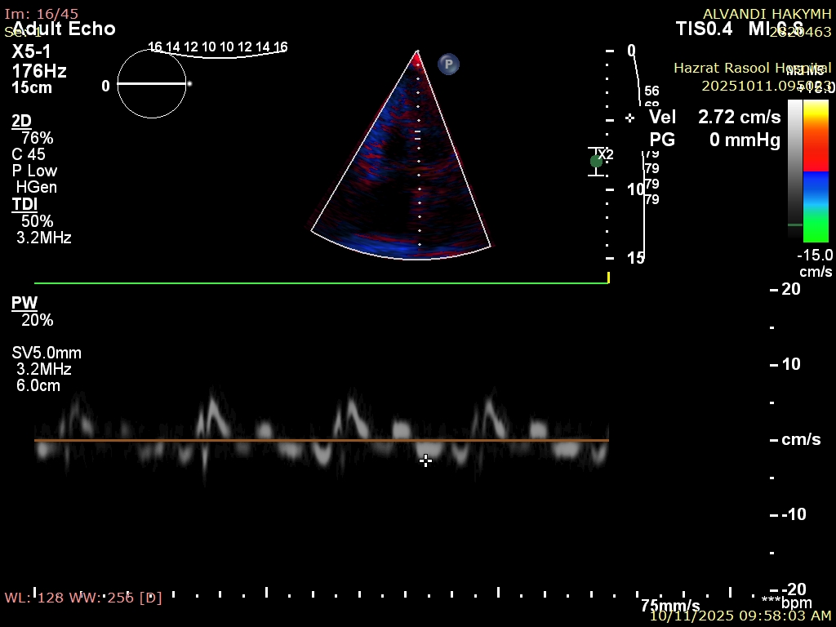
Echocardiography

Slide 29
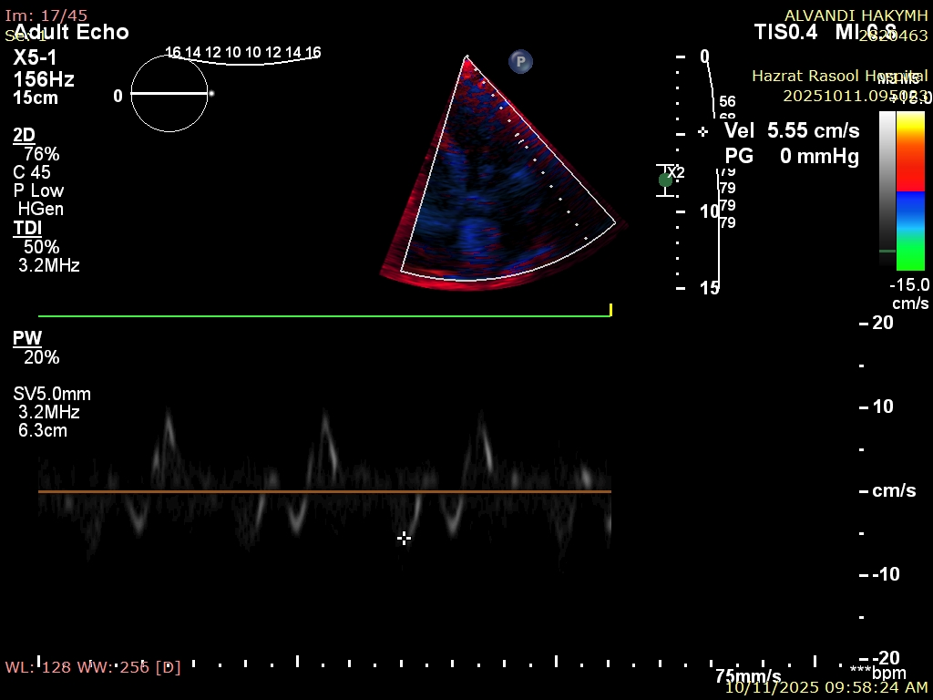
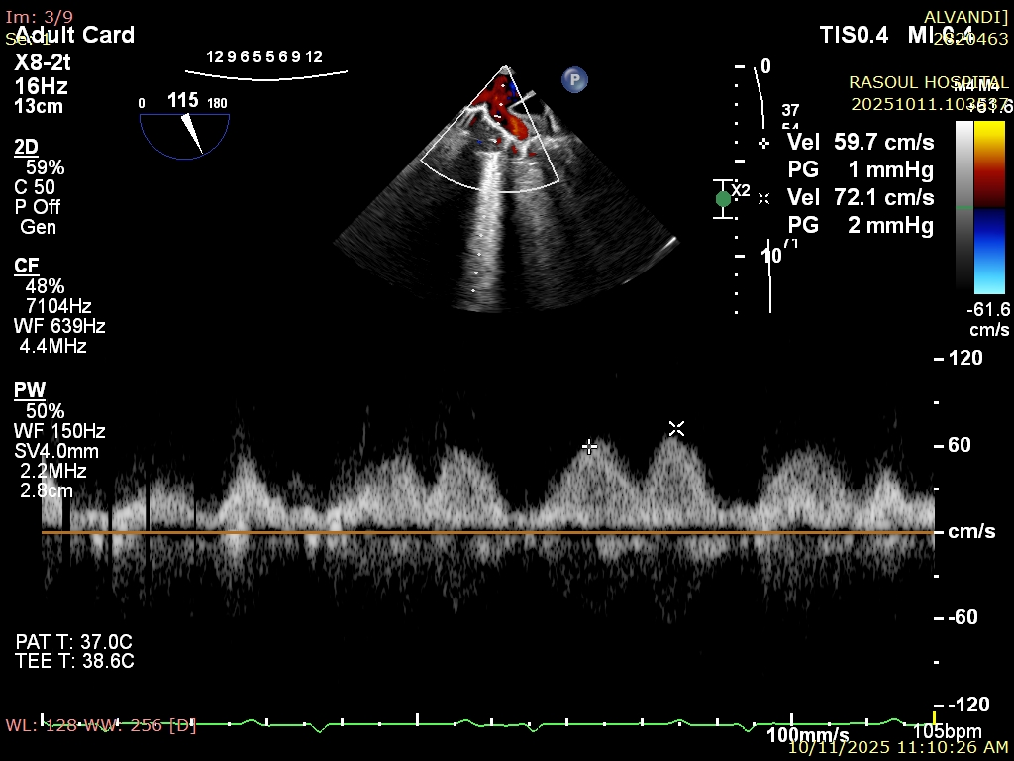
Echocardiography

Slide 30
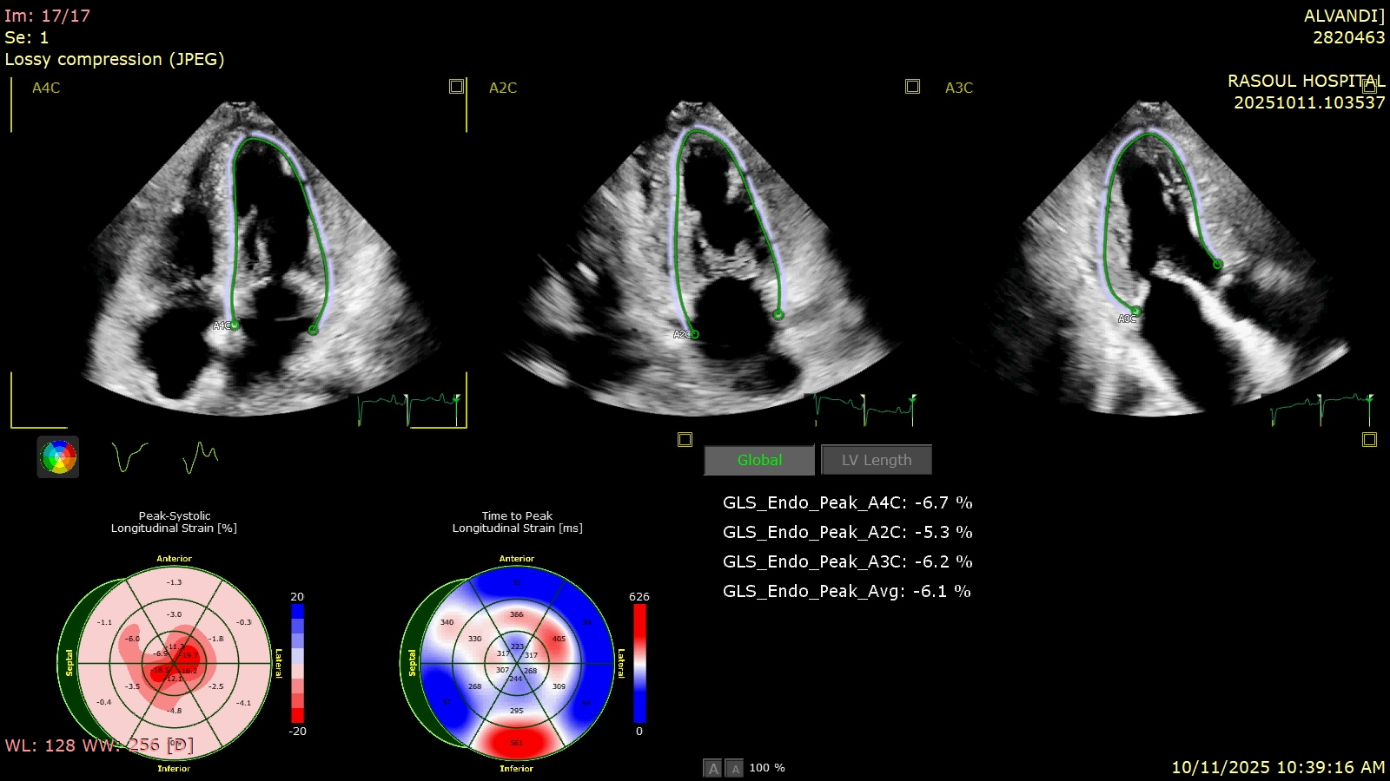
Echocardiography

Slide 31
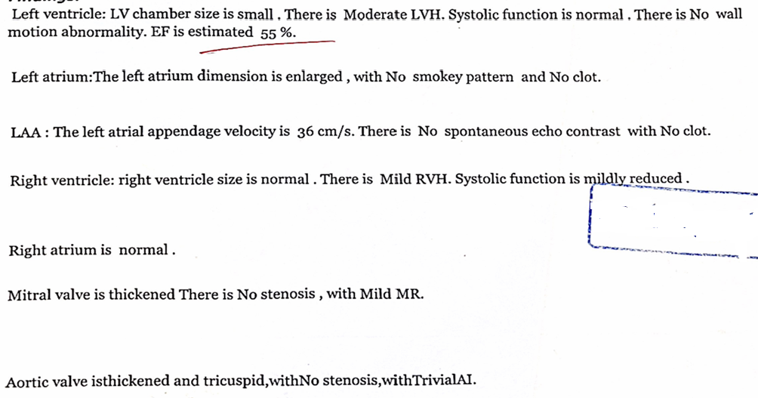
Echocardiography

Slide 32
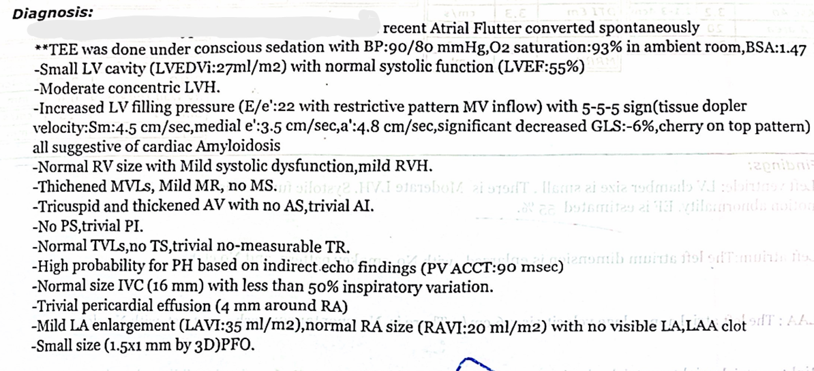
Echocardiography

Slide 33
Additional Ph/E
Macroglossia was seen in physical exam.

Slide 34
Additional lab
Pro BNP : 1630 ng/L
Urine Protein (24 hours) : 110 mg

Slide 35

STEP 4

Slide 36
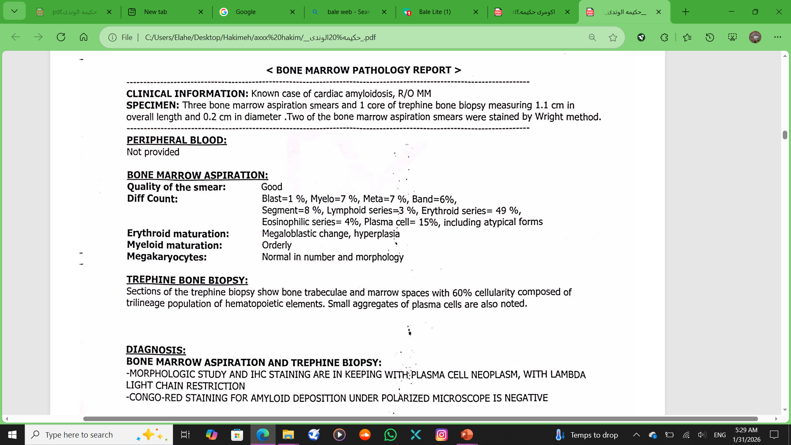
Bone Marrow Aspiration + Biopsy

Slide 37
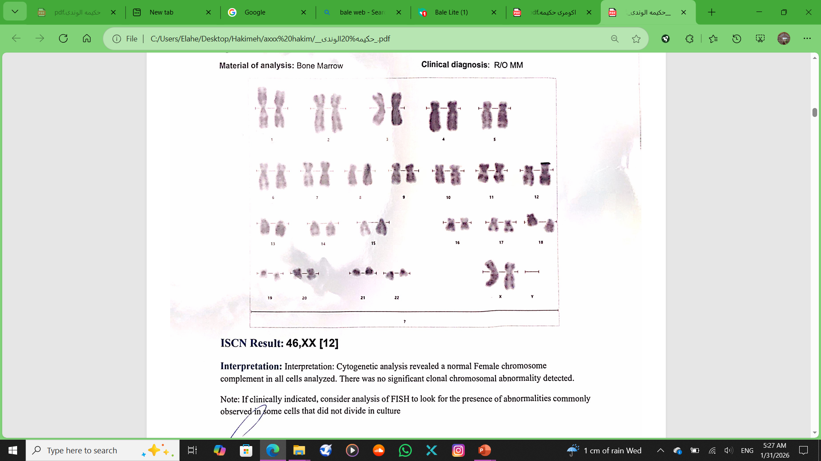
Cytogenetic report

Slide 38
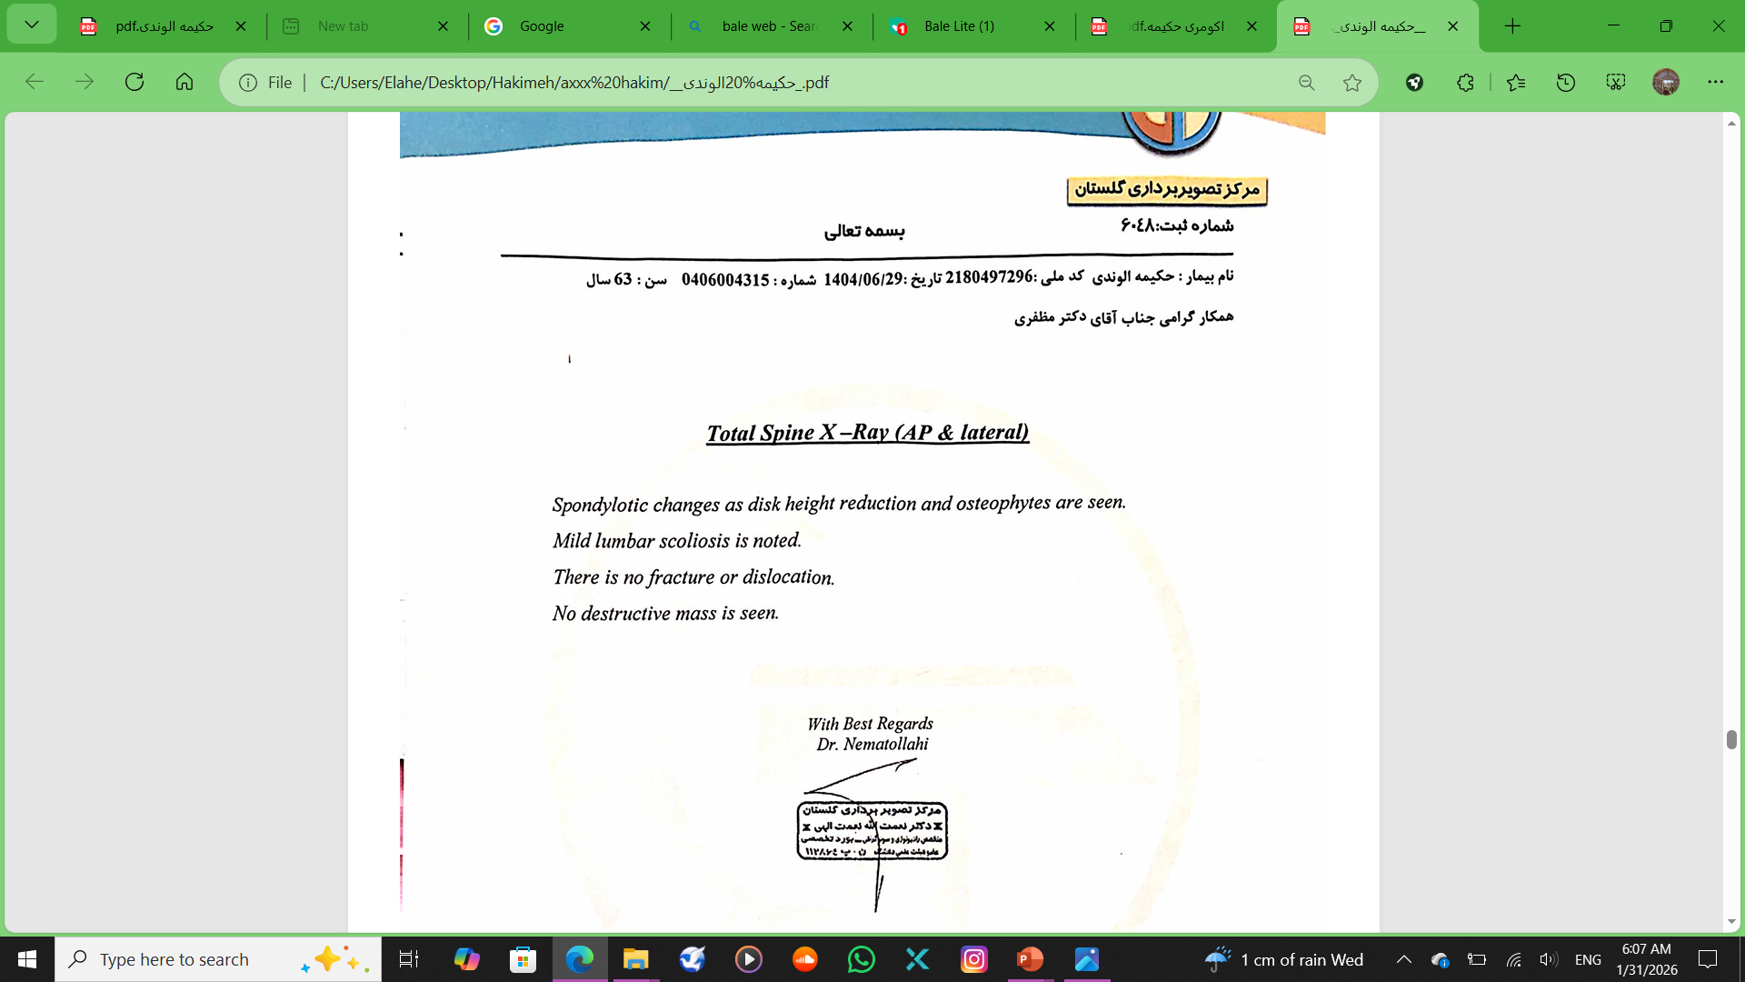
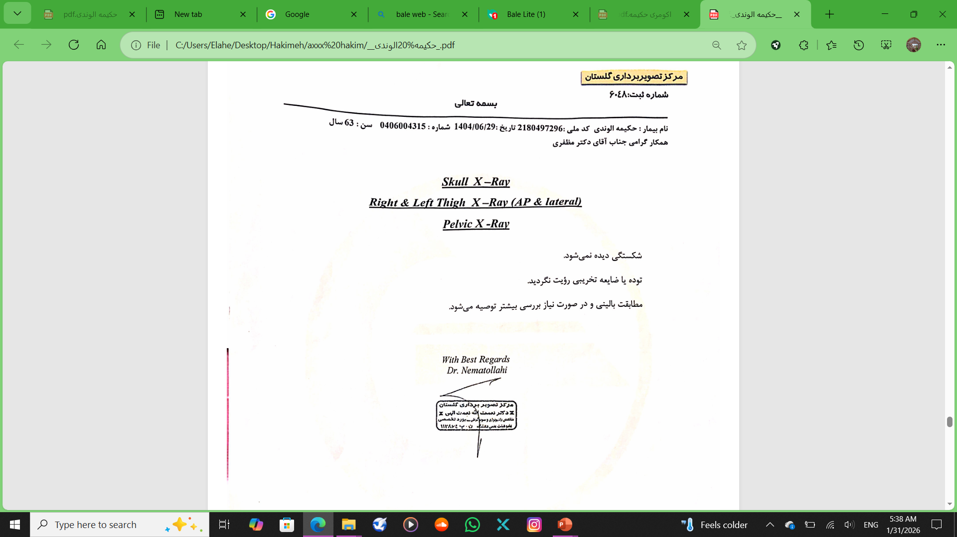
Skull and Spine X-ray

Slide 39
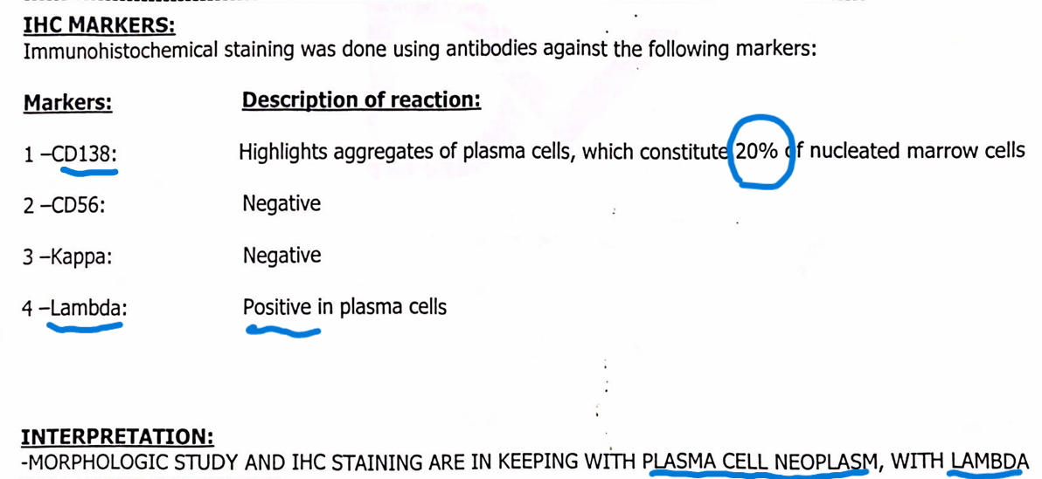
Immunohistochemical studies report

Slide 40
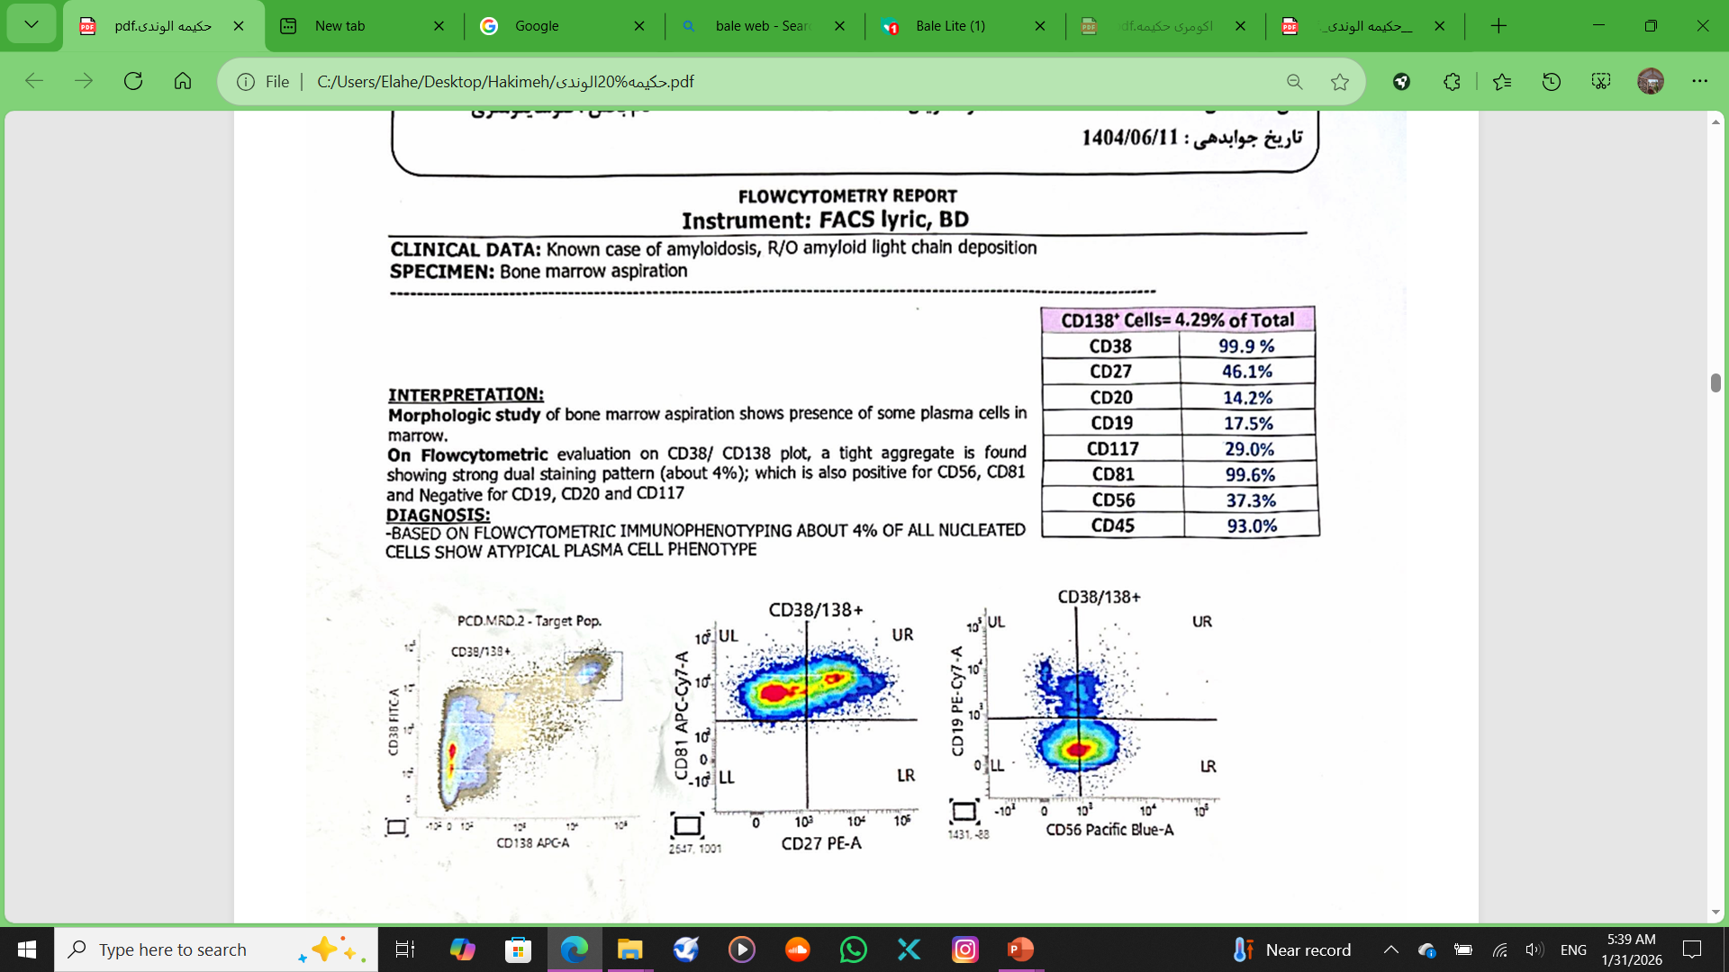
Felow cytometry report

Slide 41
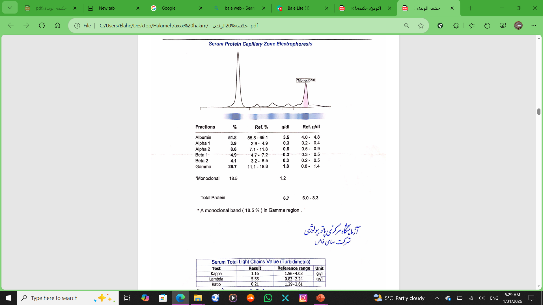
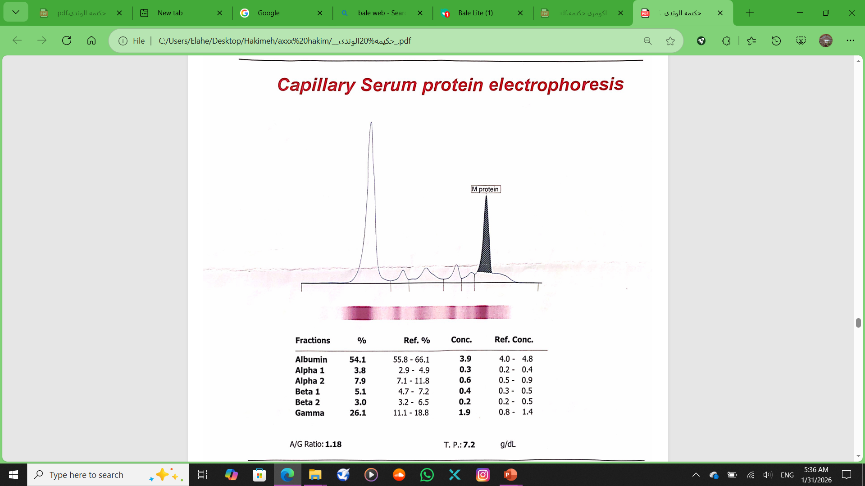
Serum Electrophoresis

Slide 42
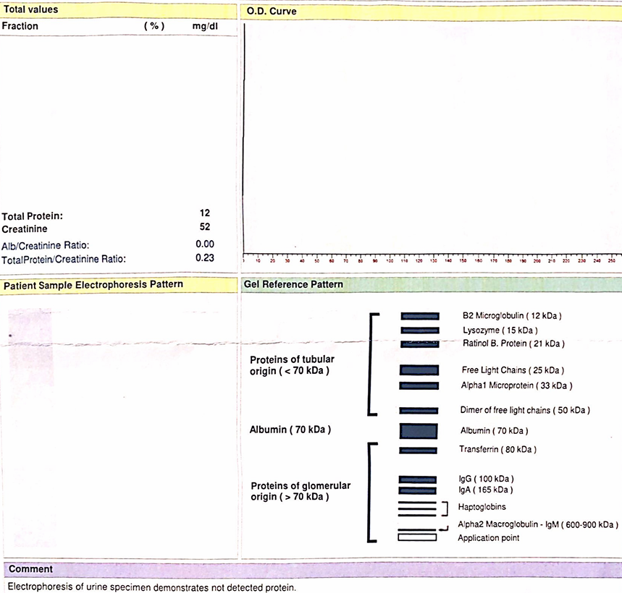
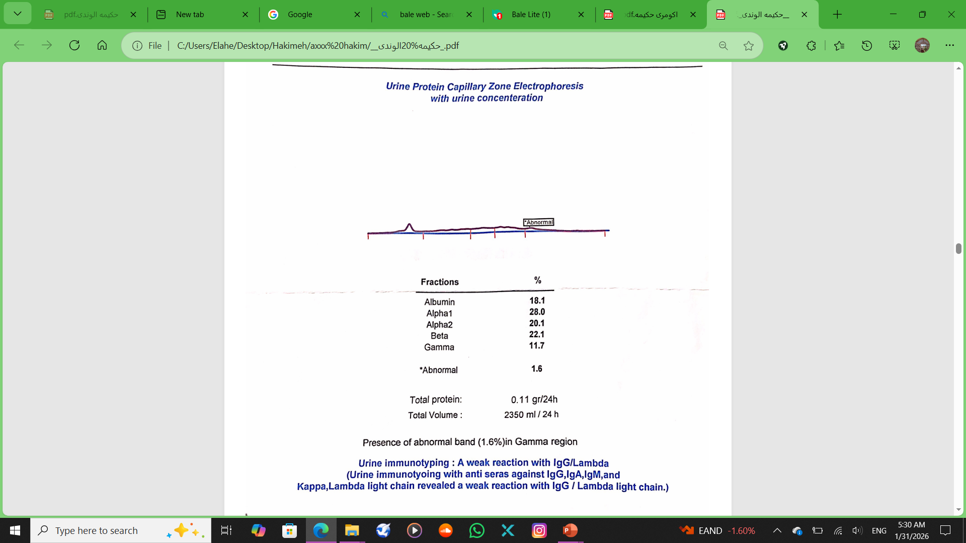
Urine Electrophoresis

Slide 43
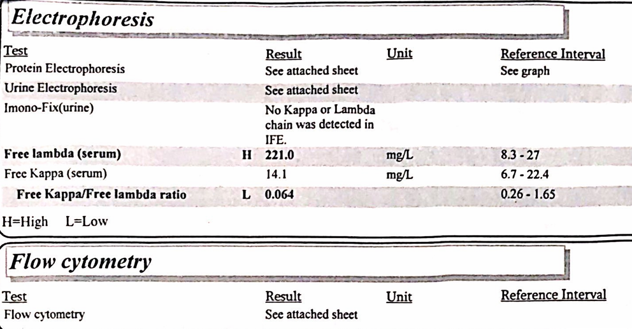
Urine Electrophoresis

Slide 44
R/O AA Amyloidosis
No history of Rheumatologic disease
No lymphadenopathy in physical exam
Normal abdominopelvic sonography
No lymphadenopathy in physical exam
Normal Endoscopy and Colonoscopy

Slide 45
STEP 5

Slide 46
TREATMENT
The patient recieved four cycles of chemotherapy with (bortezomib(Velcade), cyclophosphamide, and dexamethasone). Then, bone marrow biopsy and flowcytometry were performed again, which showed evidence of disease improvement and a reduction in the percentage of plasma cells to 3% in bone marrow aspiration and 10% in flow cytometry.

Slide 47
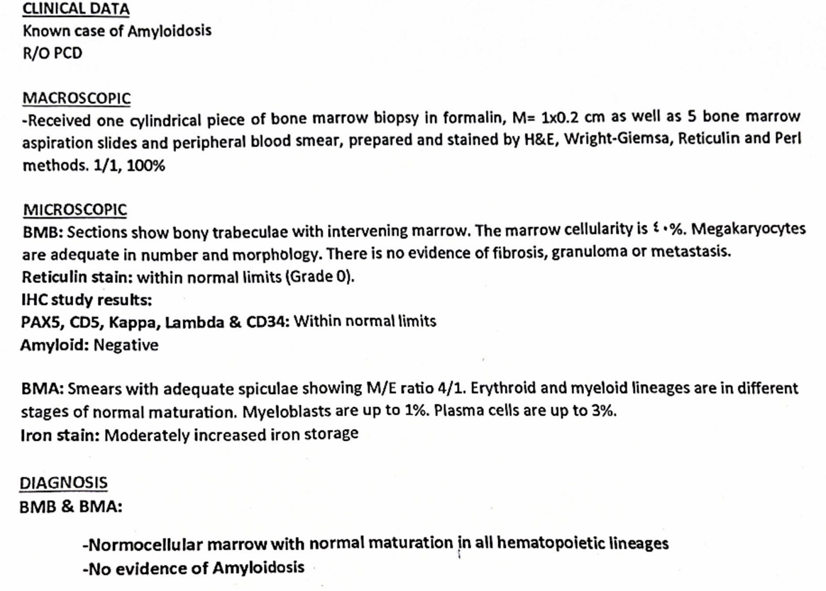
BMB & BMA

Slide 48
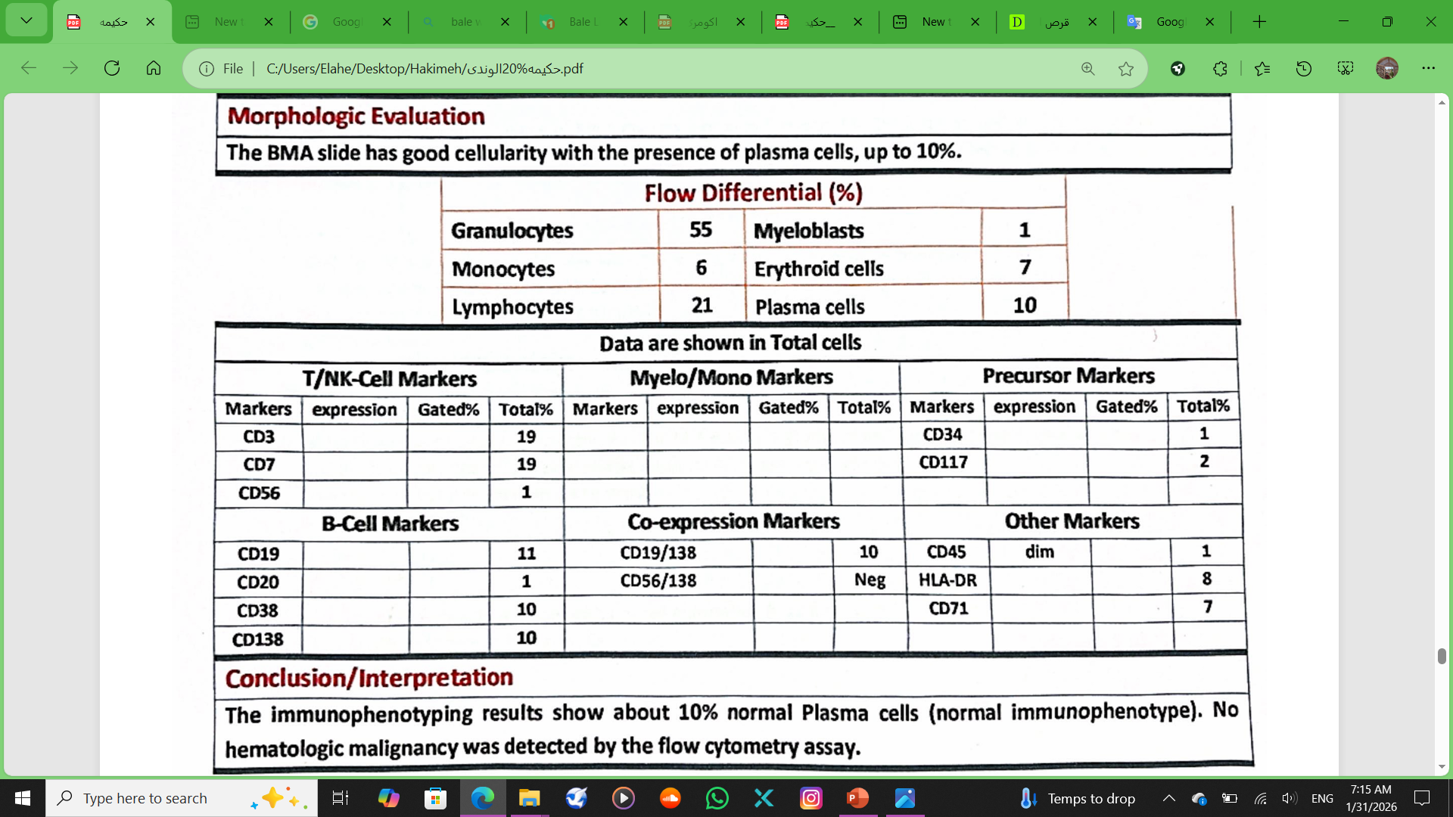
Flow cytometry

Slide 49
Progress
One month after starting chemotherapy, the patient visited a cardiologist with worsening shortness of breath and palpitations, who diagnosed her with flutter, and she was admitted to this center. A TEE was performed and found no clots, and the patient underwent cardioversion and was discharged with the recommendation to refer to another hospital for ablation.

Slide 50
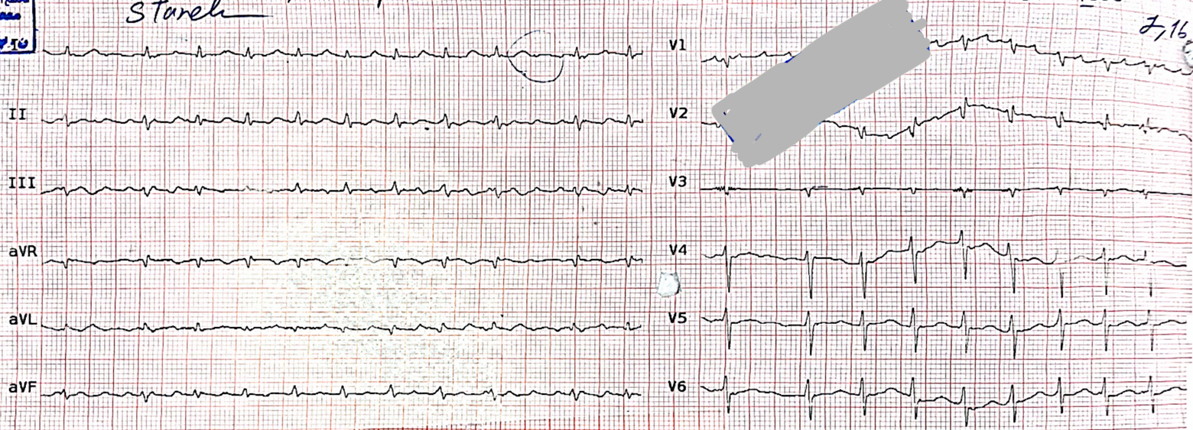
Primary ECG

Slide 51
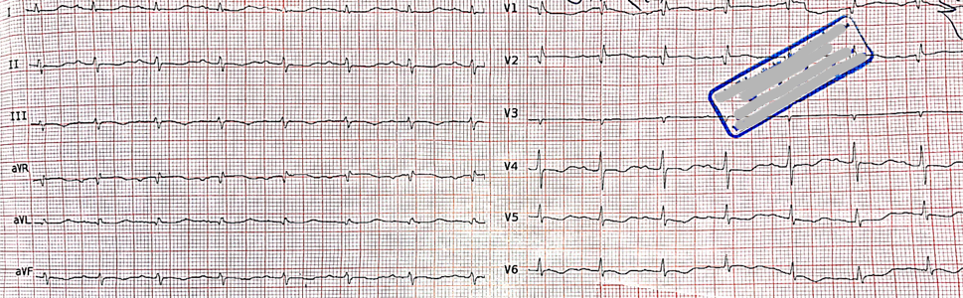
ECG after cardioversion

Slide 52
RECOMMENDATIONS AFTER DISCHARGE
Catheter ablation for atrial flutter
TAB Apixaban 5mg BD
TAB Furosemide 40mg BD
TAB Gloripa 10mg D
TAB Eplerenone 25mg D
TAB Concor 1.25 D

Slide 53


